Slide 1

Image Acquisition

Slide 2
Liver R2* acquisition
Coil
Acceleration ?
Breath-hold vs free breathing
Surface coil correction
TR and flip angle
Localization, #slices, slice thickness, gap
Echo times
Fat Saturation
Fat – Water Separation

Slide 3
Liver R2* acquisition
Coil : Torso phased array
Acceleration ? : OK
Breath-hold vs free breathing : 1 NEX vs 3 NEX
Surface coil correction : Yes
TR and flip angle : Adjust TR to coverage, flip 20°-30°
Localization, #slices, slice thickness, gap
Echo times
Fat Saturation
Fat – Water Separation

Slide 4
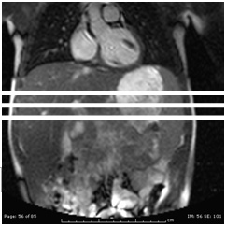
Localization
Slice to slice variability is low but I acquire three 10 mm thick slices with 5 mm gap
Avoid the costophrenic interface
I typically analyze the two best profiled with the third as a tie-breaker if there is discrepancy

Slide 5
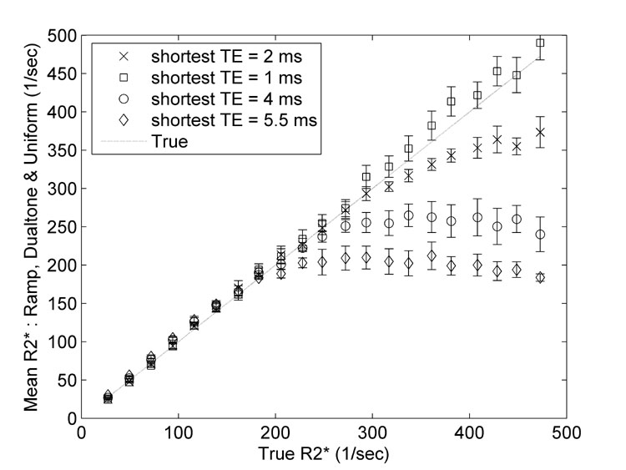
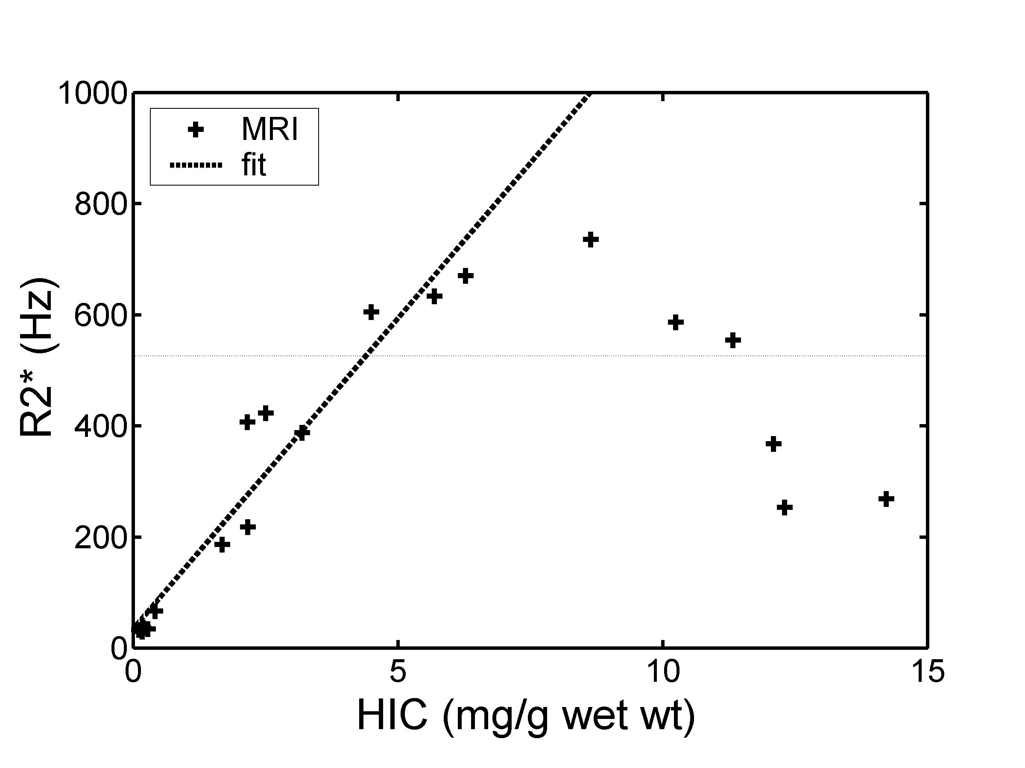
Importance of short echo times
Images represent a “mixture” of R2* rates.
Fast decaying signal is not seen at long TE.
Min TE 1.9 ms
TE = 0
TE = 1
TE = 2
T2* = 1 ms
R2* = 1000 Hz
“peak” R2* still
Near 1000 Hz
Shifted to longer T2*
Shorter R2* = less predicted iron

Slide 6
How to get a short enough TE
Use large voxels ( ⬇freq)
Maximize the bandwidth
Maximize slew rate
Can switch to single echo for tighter spacing at low TE
Really tough at 3T
First Echo Time | Maximum LIC 1.5T | Maximum LIC 3.0T
0.6 | 64 | 32
0.7 | 55 | 27
0.8 | 48 | 24
0.9 | 42 | 21
1.0 | 38 | 19
1.1 | 35 | 17
1.2 | 32 | 16
1.3 | 29 | 14
1.4 | 27 | 13
1.5 | 25 | 12

Slide 7
Impact of fat on iron measurements
T2* decay
Water only
Echo Time
1.1
2.2
3.3
4.4
5.5
6.6
7.7
Fat only
Combined
Fat spins at a different frequency than water causing oscillations.
It is out of phase at 2.2 and 6.6 ms at 1.5 Tesla

Slide 8
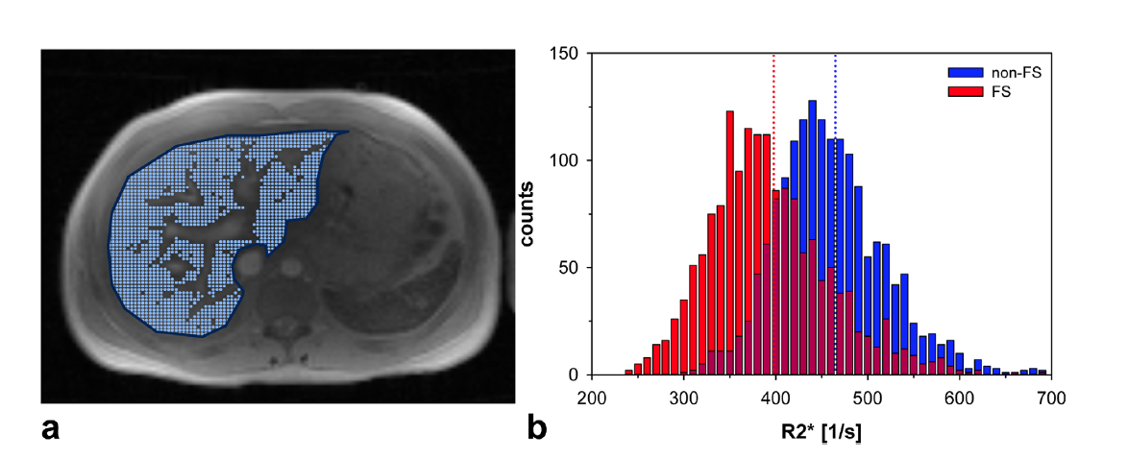
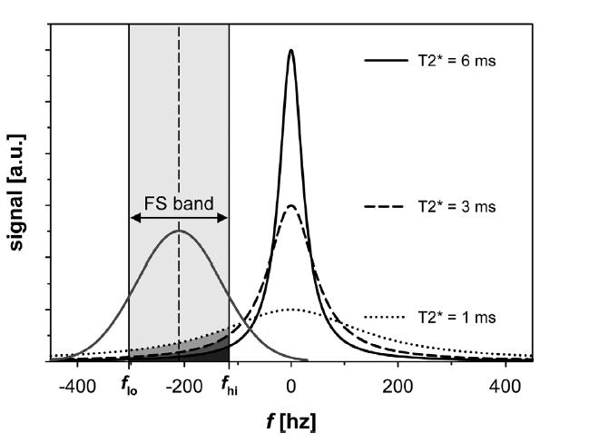
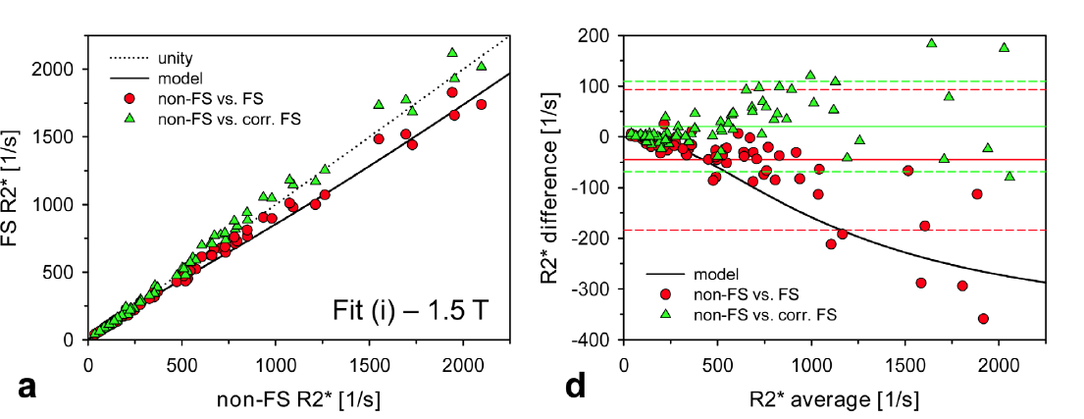
What about fat saturation ?
FS – no FS
R2* with FS
R2* without FS
Average (FS, no FS)
Meloni et al, AJR 204(3): 625-9, 2015
Krafft A et al, MRM

Slide 9
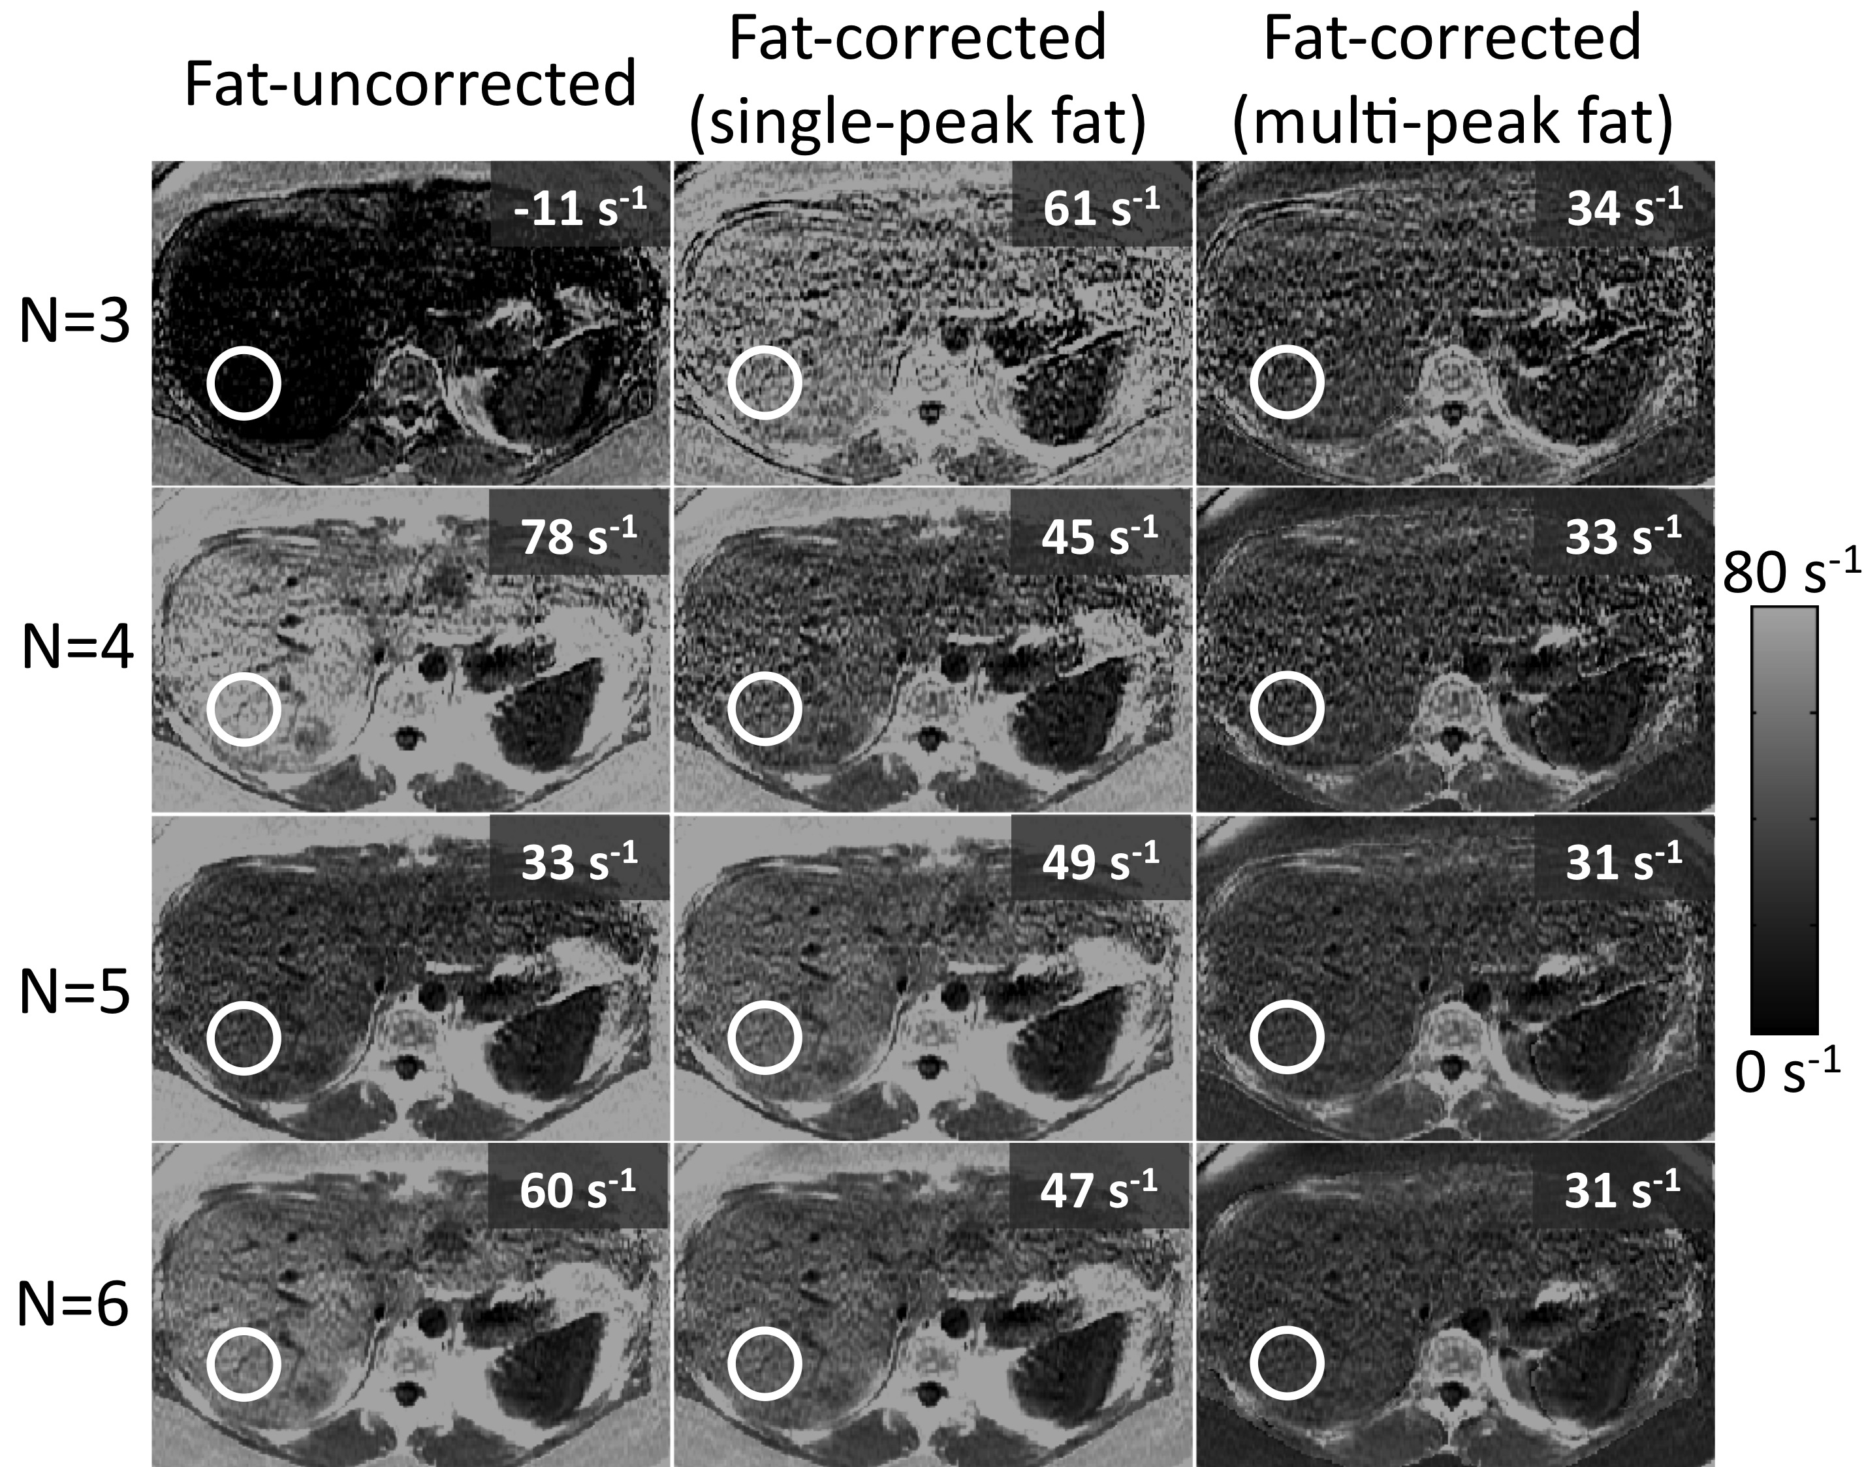
R2* Confounders: Fat
Subject with high liver fat (>30% fat fraction)
Apparent R2* very sensitive to imaging parameters if not corrected for fat.
Number of echoes used in reconstruction
Hernando D et al, Magn Reson Med 2013

Slide 10
Liver R2* acquisition
Coil : Torso phased array
Acceleration: OK
Breath-hold vs free breathing : 1 NEX vs 3 NEX
Surface coil correction : Yes
TR and flip angle : Adjust TR to coverage, flip 20°-30°
Localization, #slices, slice thickness, gap
Echo times: As fast as possible
Fat Saturation: Not for liver
Fat – Water Separation: OK for mild – moderate iron

Slide 11
How to modify for pancreas
Thinner slices
Larger SI coverage
Higher resolution (128 x 128 matrix)
May need to lower TR on Philips platform
Fat saturation OK

Slide 12
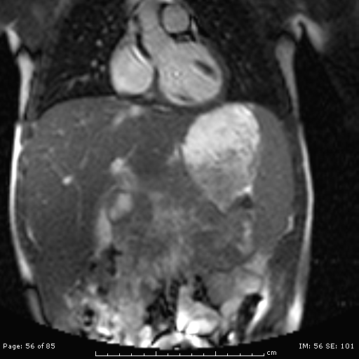
Parameters
Axial plane
5-6 thick, 0 gap
15 slices, 3 breath holds
128 x 128 matrix
TR100 (GE), 25 (Philips)
12-16 echoes

Slide 13

Questions?

Slide 14
Cardiac T2* acquisition
Coil : Torso phased array
Acceleration: OK
Breath-hold vs free breathing : 1 NEX vs 3 NEX
Surface coil correction : Yes
Fat Saturation: Not needed
TR and flip angle : Minimum TR, flip 20°-30°
Shim : Volume shim the heart
Localization, #slices, slice thickness, gap
White blood or black blood
Echo times
Temporal Resolution

Slide 15
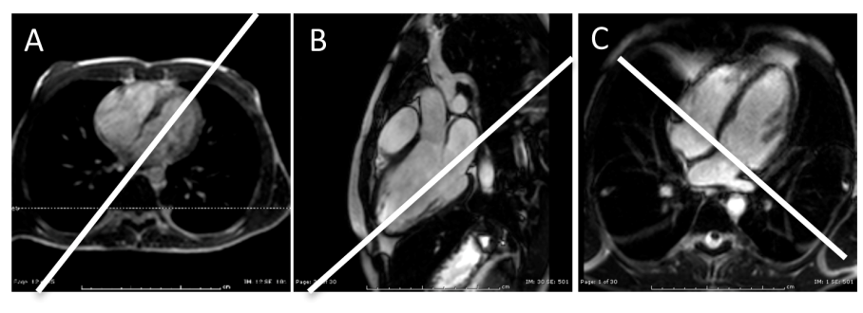
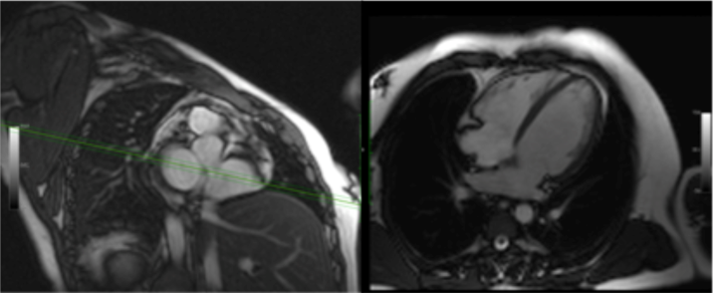
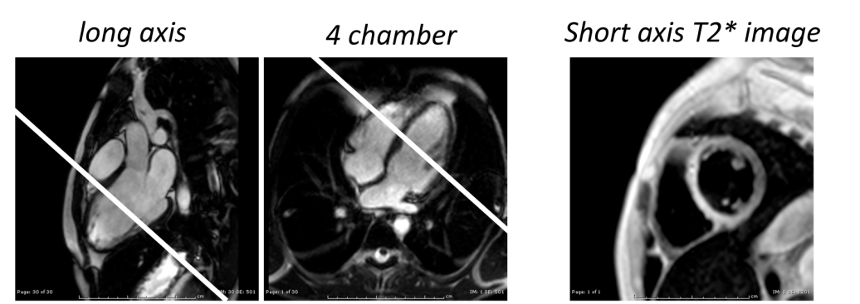
Cardiac Localization
Ungated axial SSFP
Gated SSFP cine
Gated multiecho, gradient echo sequence in the short axis plane
1-3 slices
6-10 thick, 0 gap
1 slice per BH

Slide 16
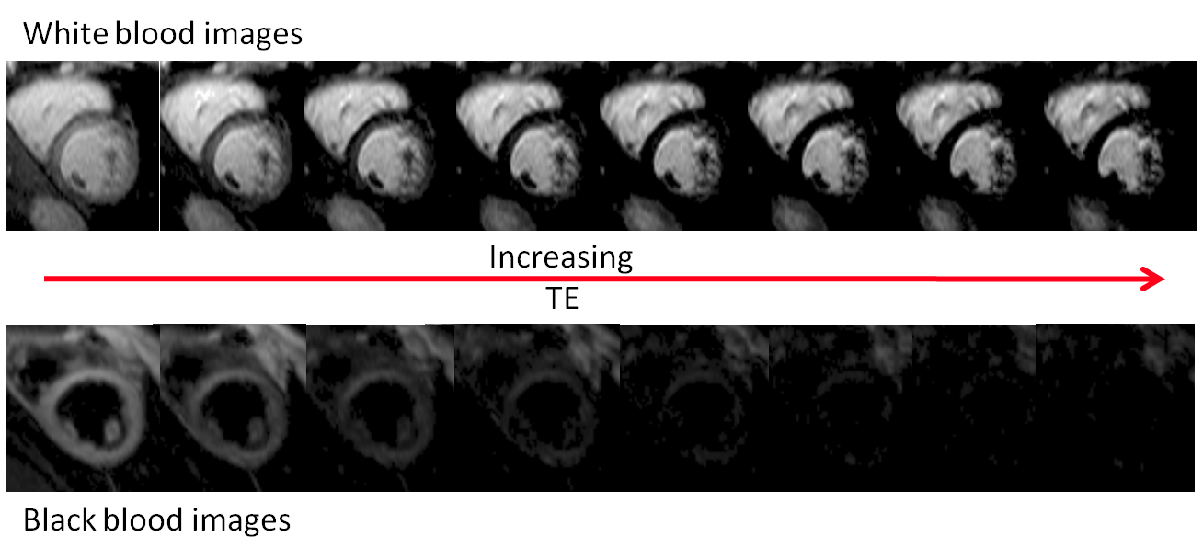
General Appearance
Iron is easy to perceive with white blood.

Slide 17
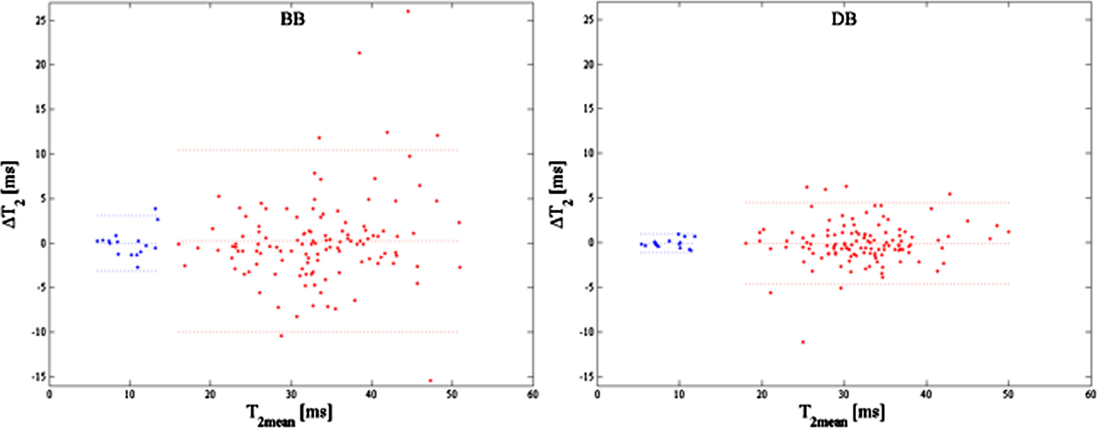
Black blood versus white blood
White Blood
Black Blood
Edge detection easier with black blood.
Better result stability in the “normal” range.
Either is suitable for clinical trials and clinical practice.

Slide 18
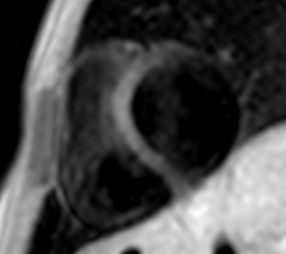
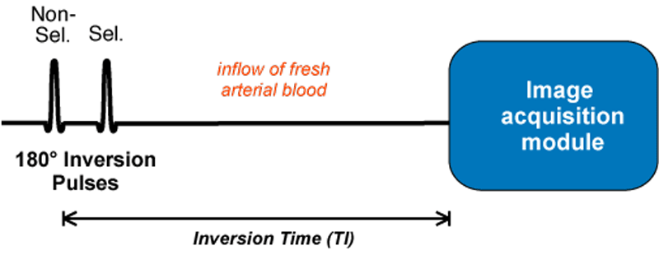
Example of B1 artifact

Slide 19
Echo Times in Heart T2*
Signal does not decay as quickly
Min TE can be as long as 2 -3 ms
Longer max TE requires longer TR -> blurring
Set max TE at ~ 18 ms
8 – 16 echoes
Some odd-even echo oscillation can occur from eddy currents
Some advocate “flyback” echo sampling.
Echo 2
Echo 4
Echo 6
Echo 1
Echo 2
Echo 3
Echo 1
Echo 3
Echo 5

Slide 20
Temporal Resolution
Cardiac motion causes T2* decay
Gating window
Arrhythmias
Respiratory motion
The heart must be nearly motionless for good T2*.
The acquisition window is TR x ViewsPerSegment (VPS)
Always set TR to “min”…~2.5 ms > longest TE
VPS is typically 8 at heart rates (HR) of 60 bpm.
Decrease VPS as HR increases.
Know that free breathing T2* in young children can lower T2* to the 20-30 range in the absence of iron.

Slide 21
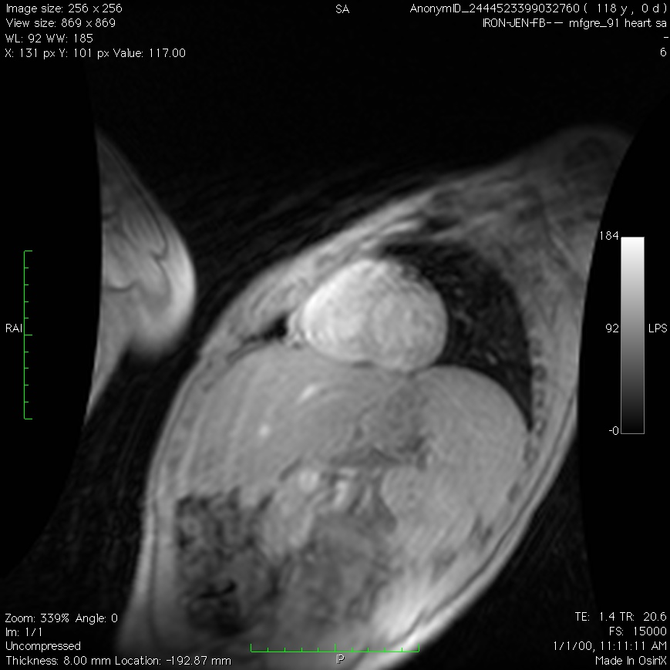
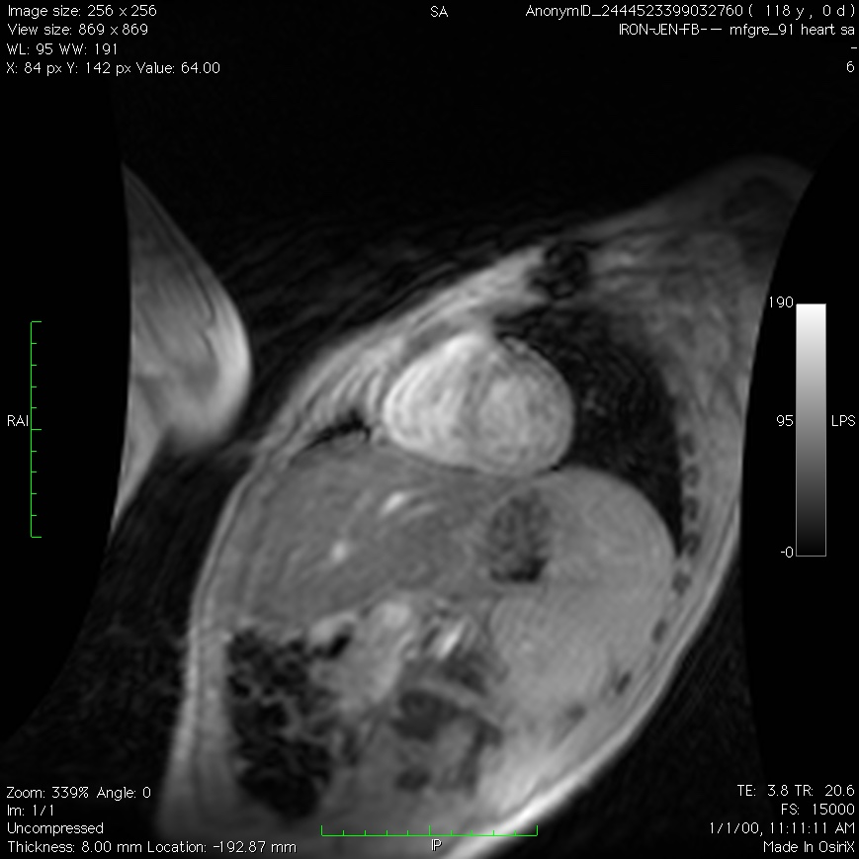
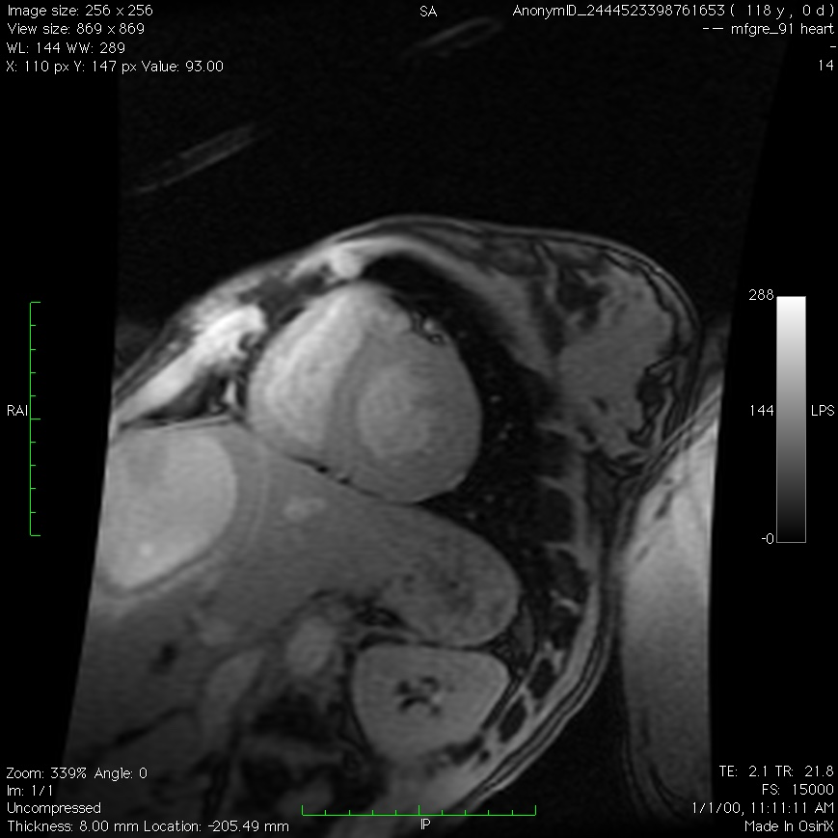
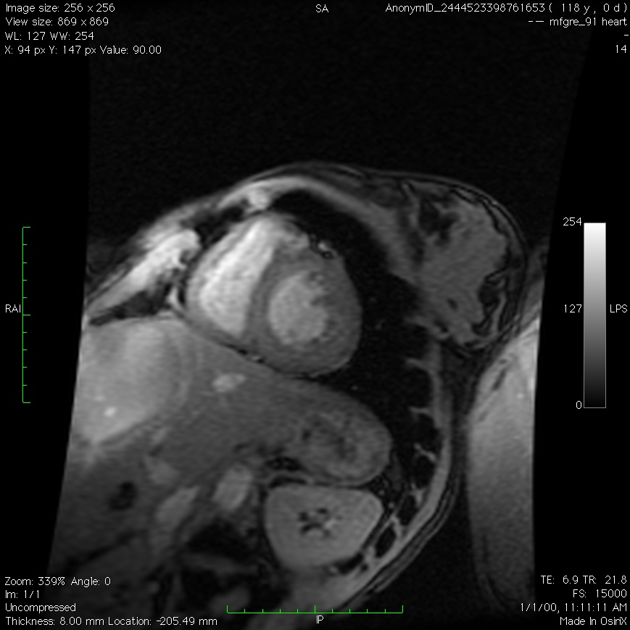
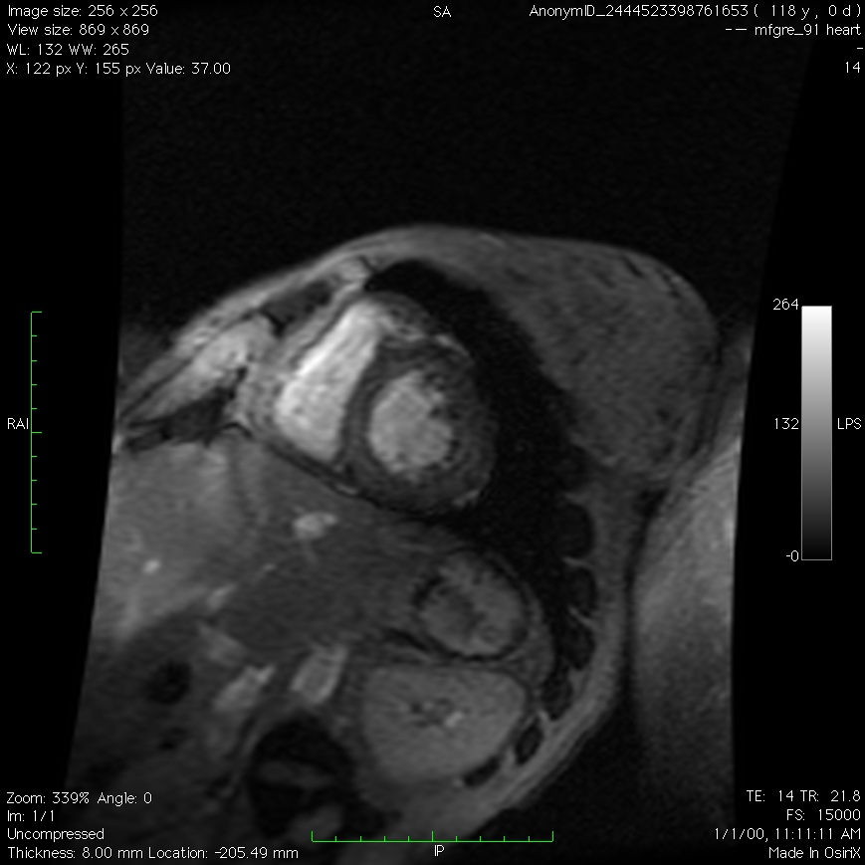
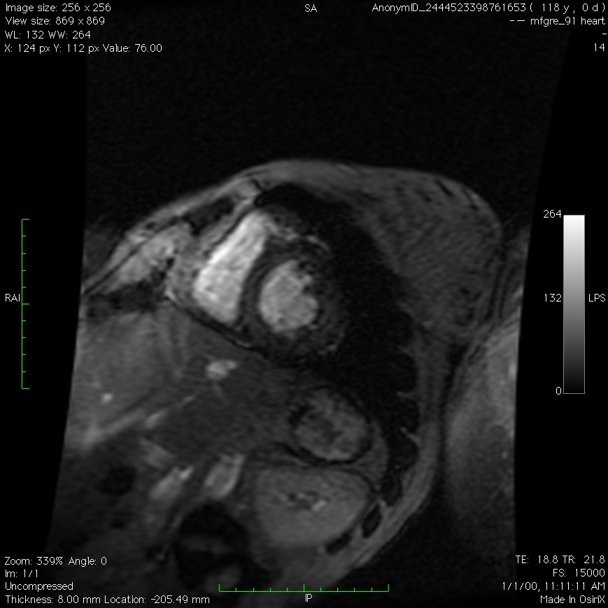
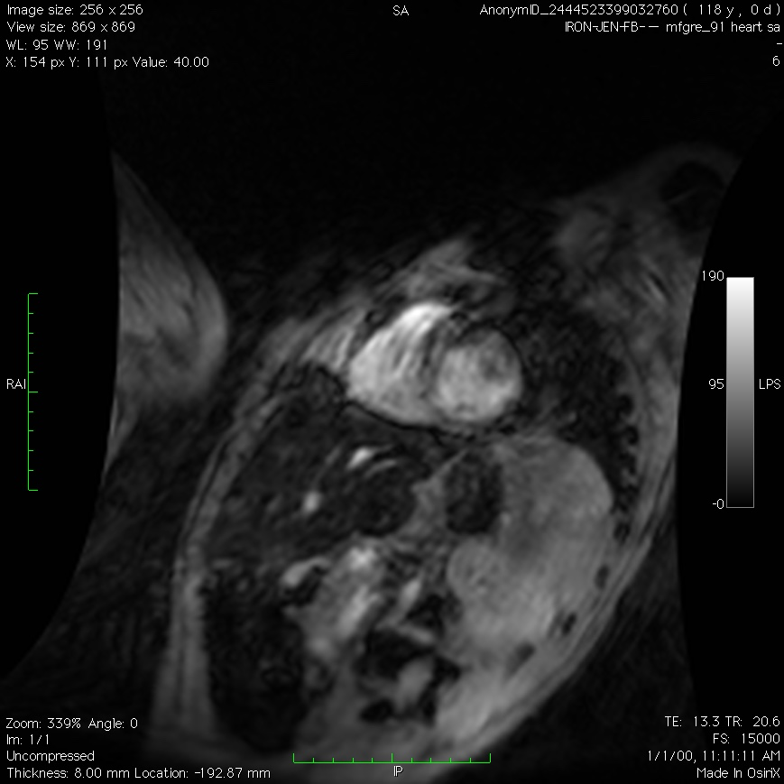
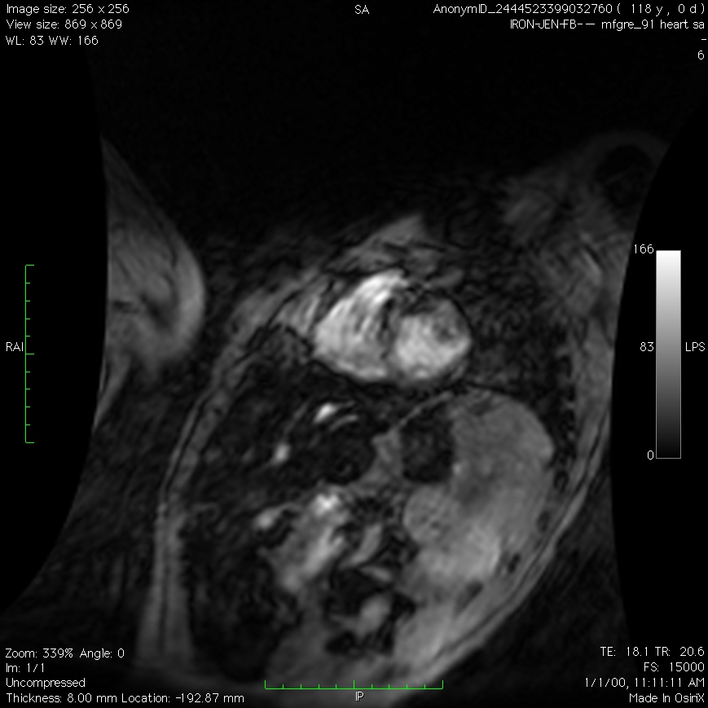
Effect of motion, example

Slide 22
Cardiac T2* acquisition
Coil : Torso phased array
Acceleration: OK
Breath-hold vs free breathing : 1 NEX vs 3 NEX
Surface coil correction : Yes
Fat Saturation: Not needed
TR and flip angle : Minimum TR, flip 20°-30°
Shim : Volume shim the heart
Localization, #slices, slice thickness, gap: 1-3 mid papillary, 6-10 mm
White blood or black blood: Either
Echo times: 2-18 ms, 8-16 echoes
Temporal Resolution: minTR & lower VPS with HR

Slide 23
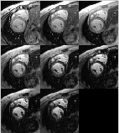
Alternatives: Single echo approach
Wood et al, SCMR, 2007
Single echo acquisition
Requires 8 breath-holds per body part (long study).
Imperfect estimates of T2*
Initial Pennell studies used this technique.

Slide 24
Questions?

Slide 25
Pituitary R2
Coil : Head
Field: 1.5 T (calibration doesn’t exist at 3.0 T)
Sequence: multiple echo, spin echo (CPMG)
Surface coil correction : Doesn’t matter
TR and flip angle : TR 500 ms, flip 90°-180° ……
Shim : Volume shim whole brain
Localization, #slices, slice thickness, gap: 1 slice, 5 mm thick, mid sagittal
Echo times: 8 echoes ranging from 15 – 120 ms

Slide 26
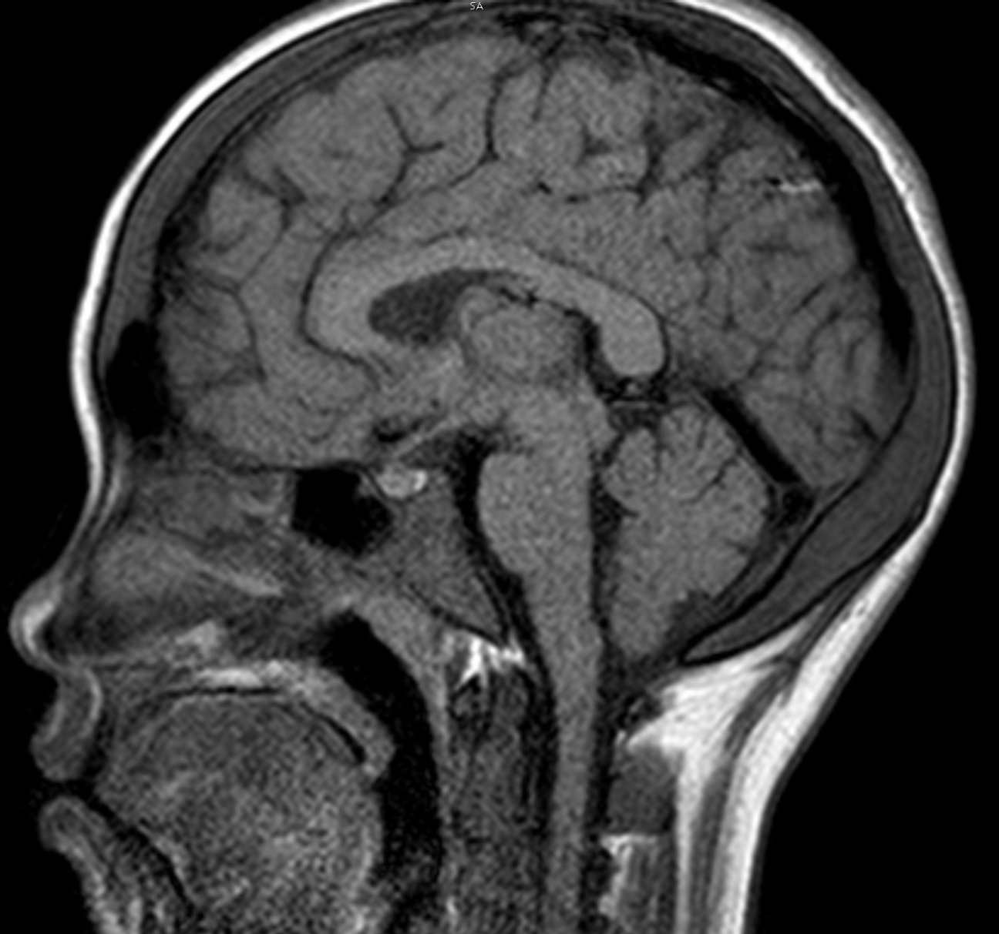
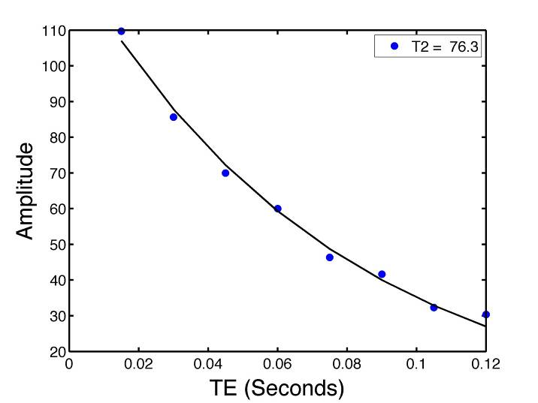
Pituitary: multiecho spin echo
GE limits to 4 echoes. Not been validated.
Pituitary volume can be derived by 3D T1-weighted GRE, 1 mm³ isotropic.
Pituitary R2 and volume norms as a function of age and sex have been published.

